Slide 1
Operating Systems
Chapter 3 (b)
Process Management
Hammad Afzal
hammad.afzal@mcs.edu.pk
Department of Computer Software Engineering
National University of Sciences and Technology

Slide 2
Roadmap
Operations on Processes
Creation of Process
Termination of Process

Slide 3
Process Creation
Parent process create children processes, which, in turn create other processes, forming a tree of processes
Create-Process System Call
Creating process is called parent process.
Created processes are called children of the process
Generally, process identified and managed via a process identifier (pid)

Slide 4
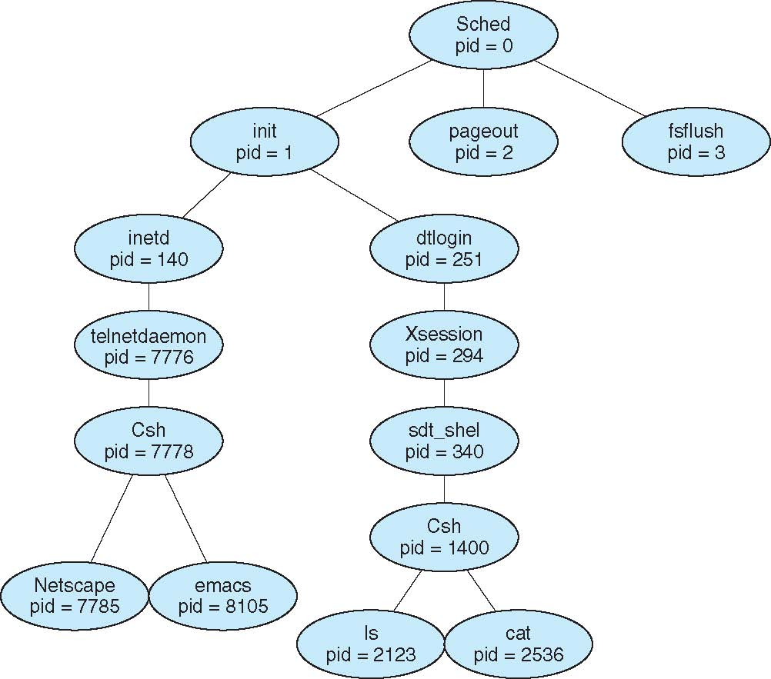
A Tree of Processes on Solaris

Slide 5
Process Creation (Cont.)
Resource Sharing
Execution
Process needs resources (CPU time, memory, files, I/O devices). Sub-process may
obtain resources from OS. OR
Obtain subset of resources of parent process. OR
Parent may partition resources or share them among children (e.g. memory, files). AND
Initializing data may also be passed to child process.
When process creates a new process, two possibilities
Parent continues to execute concurrently with children
Parent waits until some or all children terminate

Slide 6
Process Creation (Cont.)
Address space
Child duplicate of parent (same program and data as parent)
Child has a program loaded into it
UNIX examples
fork system call creates new process.
New process consists of a copy of address space of original process.
Both processes continue execution after fork():
The return code for fork() is zero for new process (child) and process identifier (of child) for parent process.
Programming: Try this at home or lab or anywhere

Slide 7
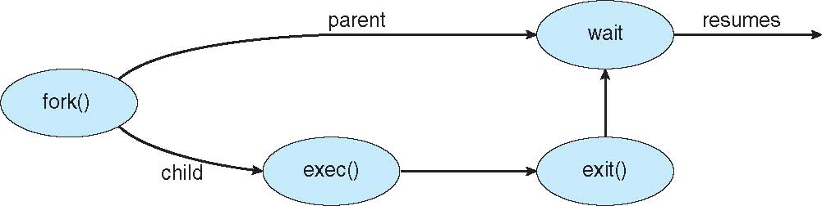
Process Creation (Cont.)
Unix Example (Contd…)
exec system call used by one of two processes after a fork to replace the process’ memory space with a new program
exec loads binary file into memory (destroying the memory image of program containing exec() and starts its execution.
Parent process either continues or creates new children or waits for termination of child (using wait() system call)

Slide 8
Process Termination
Process executes last statement and asks the operating system to delete it (exit() system call)
Output data from child to parent (via wait system call)
Process’ resources are de-allocated by operating system
Process may terminate other process using appropriate system call
Usually only parent may terminate execution of children processes (abort)
Parent needs to know the identity of children.
Programming: Try this at home or lab or anywhere

Slide 9
Process Termination
The termination can be invoked due to many reasons such as:
Task assigned to child is no longer required.
Parent is exiting and OS does not allow child to continue if its parent terminates
All children terminate with parent - cascading termination
(Additional List from Wikipedia)
Unix, parent process is informed with wait() system call about termination of child process.
Wait returns the process id of child
If parent terminates, all children processes are assigned init() as parent process

Slide 10
Some Code Snippets Not included in Theory Exam

Slide 11
C Program Forking Separate Process
#include <sys/types.h>
#include <studio.h>
#include <unistd.h>
int main()
{
pid_t pid;
/* fork another process */
pid = fork();
if (pid < 0) { /* error occurred */
fprintf (stderr, "Fork Failed");
return 1;
}
else if (pid == 0) { /* child process */
execlp("/bin/ls", "ls", NULL);
}
else { /* parent process */
/* parent will wait for the child */
wait (NULL);
printf ("Child Complete");
}
return 0;
}

Slide 12
Process Termination (Wikipedia)
There are many reasons for process termination:
Batch job issues halt instruction
User logs off
Process executes a service request to terminate
Error and fault conditions
Normal completion
Time limit exceeded
Memory unavailable
Bounds violation; for example: attempted access of (non-existent) 11th element of a 10-element array
Protection error; for example: attempted write to read-only file
Arithmetic error; for example: attempted division by zero
Time overrun; for example: process waited longer than a specified maximum for an event
I/O failure
Invalid instruction; for example: when a process tries to execute data (text)
Privileged instruction
Data misuse
Operating system intervention; for example: to resolve a deadlock
Parent terminates so child processes terminate (cascading termination)
Parent request
fatal error
Back

